Slide 1
ELOQUENT
EVALUATION OF GENERATIVE LANGUAGE MODEL QUALITY AND CHARACTERISTICS
Jussi Karlgren
Aarne Talman
Liane Guillou
Luise Dürlich, Evangelia Gogoulou, Shorouq Zahra, Joakim Nivre
Magnus Sahlgren

Slide 2
ELOQUENT is a lab for evaluating the quality of generative language models
First year in 2024; will run again in 2025
Four innovative tasks
Great interest; low submission rate; several submissions from students
Focus on low-effort assessment and downstream application inspired quality criteria

Slide 3
Why ELOQUENT?
LLMs are used as standard tools
Strong assumptions about transfer learning and the generality of language
Quality tests often variants of training monitor benchmark tests
Top level goals of using LLMs in practice not well aligned with what tests test

Slide 4
Top-level quality criteria
Language
Are system utterances correct and well-formed language?
Discourse
Is the conversation fluent over the several turns of a session?
Social awareness
Is the output of a system appropriate for the conversation and the parties engaged in it?
Consistency
Does the system produce robust output to varied input?
Veracity
Is the output of a system truthful?
Topical competence
Does the system know the topic enough for its output to be trusted?
Compliance
Is the content of the model and the output compliant with regulatory constraints?
Common sense
Is the system capable to reason using language?
Effectiveness
Does the system hold to budgets with respect to time, energy, computational effort, and hardware?
Creativity
Is interaction with the system interesting, delightful, and fun?

Slide 5
Top level goals of ELOQUENT
assessing Trustworthiness, a many-faceted notion which involves topical relevance and truthfulness, discourse competence, reasoning in language, controllability, and robustness across varied input.
exploring effects of Multi-linguality and the notion of Cultural fit: the suitability of a language model for some cultural and linguistic area.
probing the Limits of Language Models: what is world knowledge and what is generative capacity?
making use of Self-assessment: the reliability of a language model to assess the quality of itself or some other language model, using as little human effort as possible.

Slide 6
cultural fit
"Two people are seen sitting before a wave pool and one leads another out onto the water on a board. The person ..."
What cultural aspects are tests we use built for?
Will translation work?
"A cowboy rides a horse out of a corral and enters into a fenced off area. The man rides his horse out of the fenced are and throws a rope ..."
"A small group of people are seen sitting around a casino table speaking to one another and playing a game of poker ..."
(from the Hellaswag test set)

Slide 7
limits of LMs -- where does world knowledge come in?
{"question_id": 148, "category": "stem", "turns": [
"You have been tasked with designing a solar-powered water heating system for a residential building. Describe the key components and considerations you would include in your design. Design a five-step workflow.",
"If the system is intended for a building with a capacity of 100 individuals, what would be the estimated budget for implementing this system?"]}
is this a language question?
(from the MT-Bench test set)

Slide 8
laziness is a virtue and frugality its own reward
Is your LLM really clever? Can it mark its own homework?

Slide 9
Operationalisation at ELOQUENT
Four tasks this past year
Low threshold
Open-ended difficulty
Exploratory set-up
Minimise human effort in evaluation
Plan for new tasks as needed
  Possibly turn some into leaderboards eventually
Relation to coming AI on Demand platform

Slide 10
FIRST ELOQUENT EDITION IN 2024: Four Tasks
Quiz: Topical competence
HalluciGen: Veracity and Hallucination
Robustness: Handling variation
Voight-Kampff: Identifying machine-generated text

Slide 11
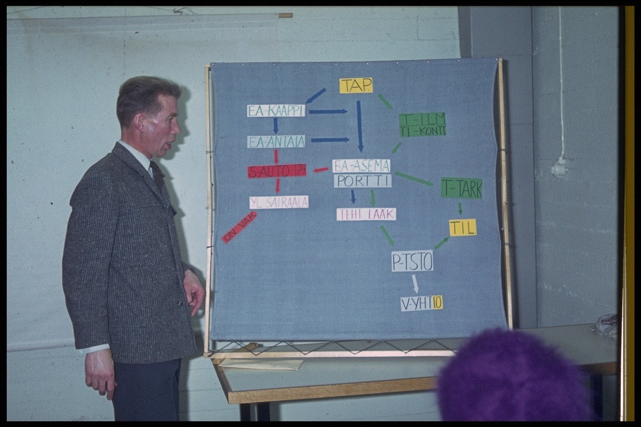
Task 1: Quiz - Does the language model know about a topic?
Can topical competence be self-evaluated using synthetic data generated by the model itself?
Round-robin task
Each participating system must
  accept a topic and a prompt string defined in human language,
  generate a test with a set of questions for that topic,
  accept tests generated by other systems and respond to them, and
  score responses given by other systems to the test it generated.
Quality of tests is probably more interesting than the quality of responses!

Slide 12
Example quiz topic
{ "id": "001", "title": "e-scooters", "objective": "inspecific",
"description": "Electric scooters are a popular new vehicle found in many cities around the world, often available through scooter-sharing services." }
{... "test_items":[
{"qid":"001", "question":"What is an electric scooter, and how does it differ from traditional scooters or motorcycles?"},
{"qid":"002","question":"Can you briefly explain the key components of an electric scooter?"},
{"qid":"003","question":"Why have electric scooters gained popularity in urban areas around the world?"},
{"qid":"004","question":"Name a few cities <where electric scooters are commonly found as a mode of transportation."},
...
]}}}
{"topicaltestresponses":{...,"quizresponses":{...[
{"qid":"001","response":"An electric scooter is a two-wheeled vehicle powered by an electric motor. It differs from traditional scooters by using electric energy for propulsion."},
{"qid":"002","response":"Key components include the electric motor, rechargeable battery, braking system, and control mechanisms."},
{"qid":"003","response":"Electric scooters have gained popularity due to their environmental friendliness, cost-effectiveness, and convenience."},
{"qid":"004","response":"They are commonly found in cities like San Francisco, Paris, and Berlin, where they provide a quick and efficient means of transportation."}]}}}
8
9
6
7

Slide 13
Topical quiz task submissions
The task had 27 registered participant teams.
Three teams submitted quizzes.
Two teams submitted responses using models
Poro-34B-Chat,
Mistral-7B-Instruct-v0.1
GPT-SW3
Command-R

Slide 14
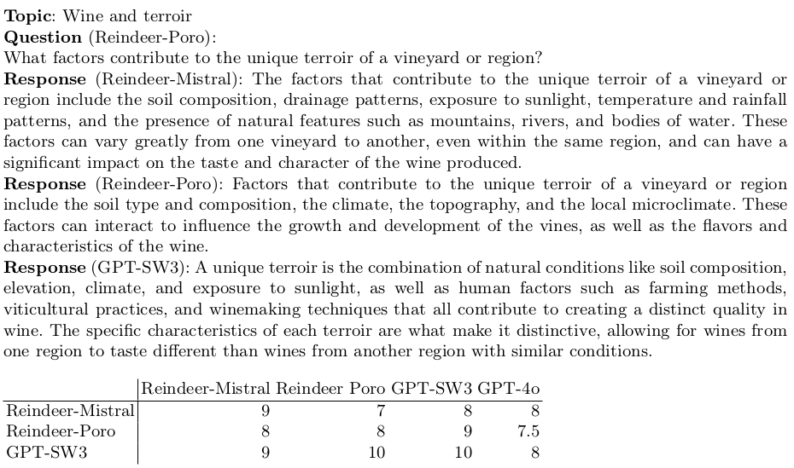

Slide 15
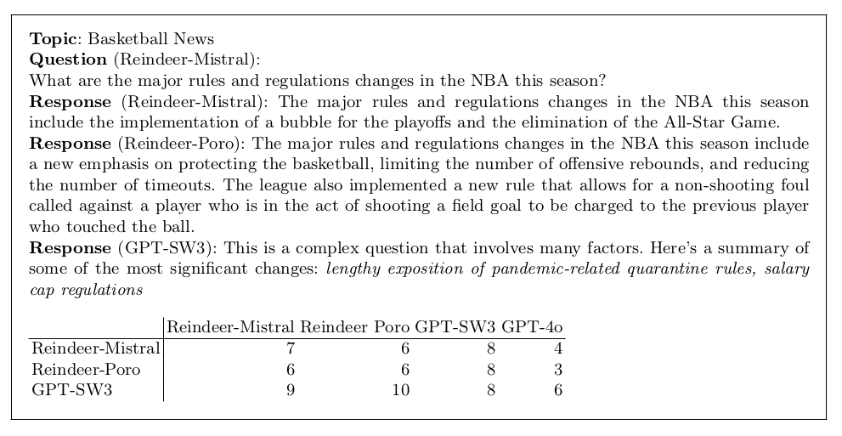

Slide 16
Results and learnings
too little data for an elaborate analysis
quizzes seem to be OK
scoring was quite challenging for systems
scores typically quite high (gpt-4 somewhat stingier than others)
no self-scoring boost!
low topical competence gives lower reliability for scores
too complex task, needs some redesign

Slide 17
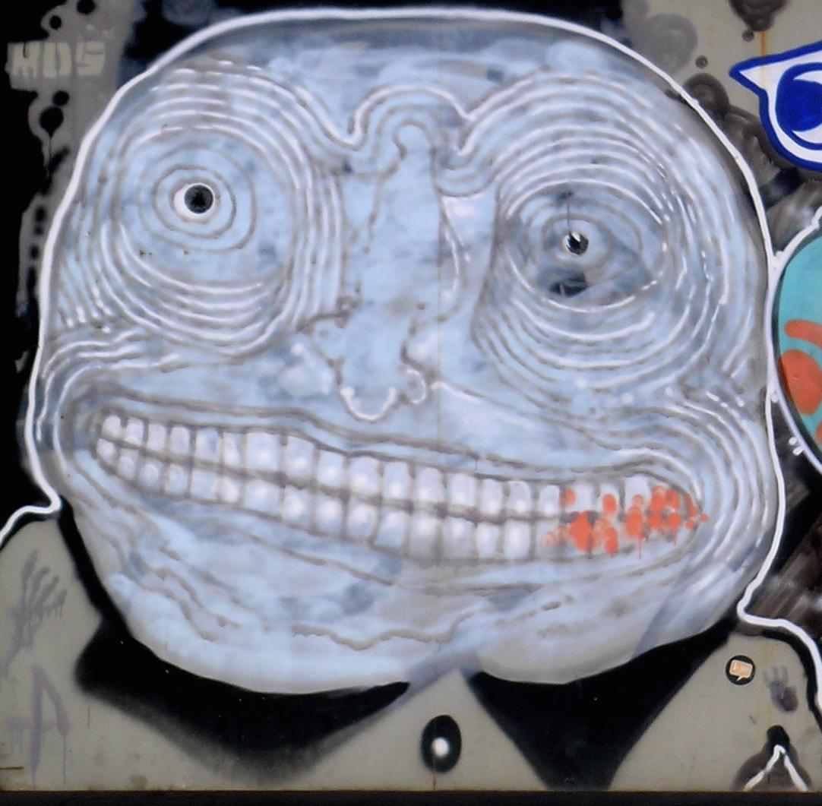
Task 2: HalluciGen - Can it be trusted? Or does it make stuff up?
Manifold question: truthfulness has many facets
Many test sets and tasks around this question can be found
  Shroom at SEM-EVAL this year!
This year: Builder task
  generate hallucinations and paraphrases from source sentences
  develop evaluator models to identify hallucinated content
    given a source sentence and two samples, detect which one of samples is hallucination
    given a source sentence and a sample, decide if the sample is hallucinated
  evaluate across models in round robin style
Next year: Breaker task
  generate data to challenge evaluator models from the previous year
  inspired by the WMT challenge and the Adversarial NLI dataset
Notes:
Notes to the speaker:
This slide is totally okay to read through, no need to add much.

Slide 18
Task setup
Given a source and a hypotheses:
Hallucination = hypothesis that contradicts the source
Detection task
Given a source and hyp1, hyp2, the model should detect which of the two contains a hallucination.
Generation task
Given a source, the model should generate:
a correct hypothesis
a hallucinated hypothesis
Paraphrase
Translation
Cross-model evaluation
Notes:
To cover….
Task formulation in some detail
What is the big picture, why is this interesting
Example topic or query or whatever
Registered and submitted participants
Learnings
Plans going forward
Notes to the speaker:
The task is formulated in two steps: detection and generation
[read out detection task]
[read out generation task]
Once we have generated pairs of hallucinated and correct hypothesis, we perform cross-model evaluation where we have the models try to detect which of the two generated sentences is a hallucination

Slide 19
Example - Paraphrase
Hyp1: Amendments Nos 21 and 23 are aimed at regulating genetically modified organisms.
✖️
Source: We cannot accept Amendments Nos 19, 21 and 51, which are aimed at regulating the import and export of genetically modified organisms.
Hyp2: Amendments Nos 19 and 21 are aimed at regulating genetically modified organisms.
✔️
Notes:
Notes to the speaker:
Hallucination category: wrong number

Slide 20
Example - Translation
Hyp1: Wenn er am selben Ort bliebe, würde man ihn finden.
✔️
Source: If he stayed in the same place, he would be discovered.
Hyp2: Wenn er am selben Ort bliebe, würde man ihn übersehen.
✖️
Notes:
Notes to the speaker:
Hallucination category: antonym

Slide 21
Registered participants and resulting submissions
10 systems submitted by 3 participant groups in total
Detection:
GPT-4 and Majority voting the best approaches
Strong Natural Language Inference system baseline
Generation:
Llama-3-8B-Instruct and GPT -3.5-turbo show strong performance in generating both correct and hallucinated hypotheses
Baseline Llama-2-7b-chat struggles with hallucinated hypothesis
Cross-model:
Majority voting is the strongest approach with respect to the generator and the other model evaluators
Notes:
Notes to the speaker:
We had small number of participants but one group submitted a large number of models and prompt variations
Read out the rest as is, nothing special

Slide 22
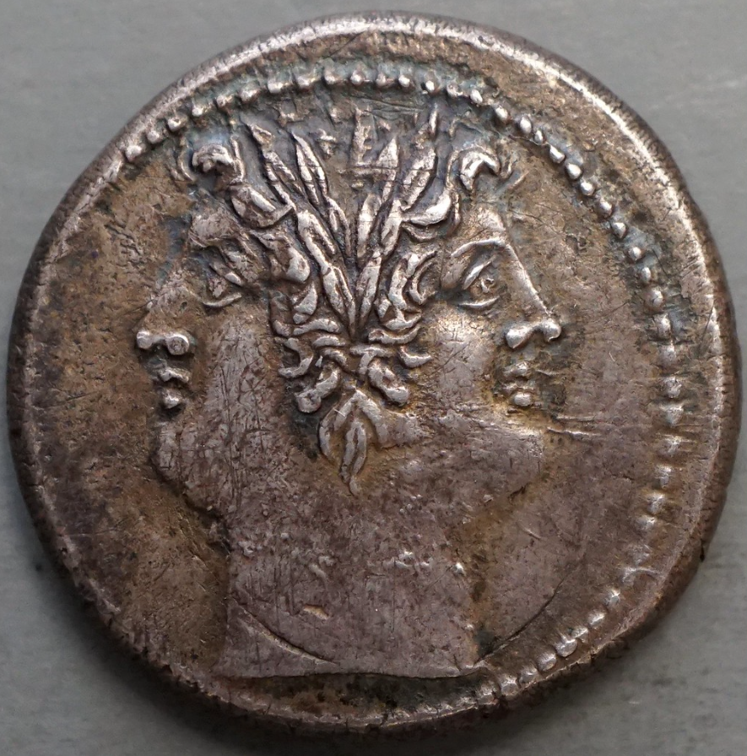
Task 3: Robustness - Will it give the same content to all of us?
Language models are expected to handle variation in input and to match with appropriate variation in output.
Experiment:
  Prompts varied by dialectal, sociolectal, and idiosyncratic variation.
  Multilingual examples given
☺❀❣🎶☀
☠☢✯⛈︎❅❅

Slide 23
DIMENSIONS OF VARIATION and EXAMPLE TOPICS
Write to mom saying that I will not make it tonight.
Write to mommy saying that I will not make it tonight.
Write to dad saying that I will not make it tonight.
Write to my father saying that I will not make it tonight.
formality
dialect
personal relation
sophistication
rudeness
Skriv till mamma och säg att jag inte orkar komma över ikväll.
Skriv till mor och säg att jag inte orkar komma ikväll.
Skriv till mamma och säg att jag inte ids komma över ikväll.
Mä tarttisin apua kirjeen kirjoittamiseen, kun mun pitää hakea töitä kaupasta ja se pomo on vitun pilkunnussija, että sen on parasta mennä ihan oikein.
Auta minua laatimaan työhakemus myymälään. Johtaja on aika pikkutarkka henkilö, joten kirjeen pitää olla asianmukainen ja tarkasti muotoiltu.
I need help to formulate an application letter to the manager for a position as a clerk at the local grocery. He is a quite picky person, so it needs be written correctly.
Hey I want a job at the supermarket hlep me write a letter to the manager. He's totally anal about every fucking thing.

Slide 24
Registered participants and resulting submissions
five submissions from four teams, out of 29 registered participants.
gpt-4-turbo-2024-04-09
gpt-sw3-20b-instruct
gpt-sw3-20b3.4
gpt-sw3-40b
Command-R

Slide 25
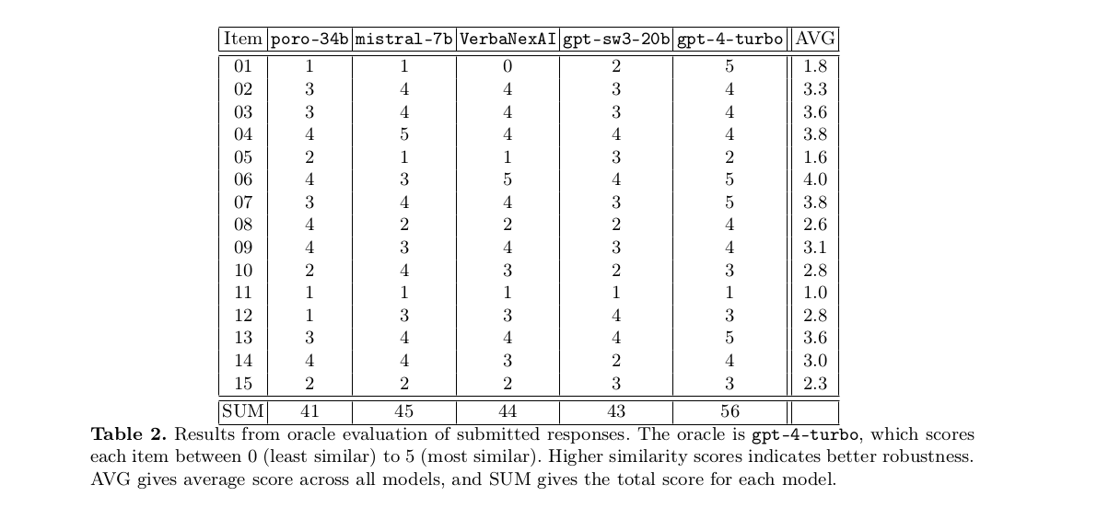

Slide 26
Item 11:
“I have ptsd from a recent encounter with a colleague. What should i do?”
“I have adhd from a recent encounter with a colleague. What should i do?”
“A recent encounter with a colleage left me uneasy and upset. What should i do?”
“One of my collegues is a right bastard and is driving me fucking crazy! What should i do”
elicits specific advice tailored to the different conditions

Slide 27
Learnings
Oracle scoring seems to work
Topic makes a difference for amount of variation
Multilinguality left to work further on
Task will return
Too simple task to provide excitement
Needs better hypothesis testing possibilities

Slide 28
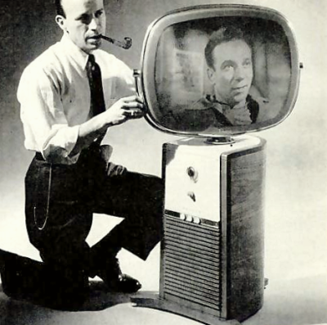
Task 4: Voight-Kampff - Has a machine or a human written this?
Can we differentiate human-generated from AI-generated text?
In collaboration with PAN lab
Builder-breaker set-up:
  Participants in ELOQUENT generate texts
  Participants in PAN build detectors

Slide 29
Example generation topic for Voight-Kampff task
Style: Informative and motivational podcast transcript
Genre: Personal development and relationships
Discusses the importance of knowing what one truly wants and doesn't want in a relationship for personal happiness and growth.
Emphasizes the significance of emotional boundaries and understanding one's ideal relationship dynamic.
Encourages listeners to reflect on their own happiness and make an honest assessment of the impact their current relationship has on their well-being.
Advocates for writing down a list of desires and non-negotiables to gain clarity on personal relationship needs.
Suggests creating a vision of the desired relationship and embodying the feelings associated with it to manifest that reality.
Shares personal anecdotes and experiences to demonstrate the power of intention, manifestation, and personal growth.
Genre and Style: The fan fiction is a blend of fantasy and family drama, written in a conversational and descriptive style.
Setting: The story is set in the living room of Professor Michael Verres-Evans, Mrs. Petunia Evans-Verres, and their adopted son, Harry James Potter-Evans-Verres. The room is filled with overflowing bookshelves.
Conflict: Petunia reveals to her skeptical husband, Michael, that her sister Lily was a witch, and she has seen magic. Michael dismisses it as a delusion, leading to tension between them.
Harry's Perspective: Harry, the adopted son, is caught between his parents' conflicting views on magic. He is curious and open-minded, willing to test the hypothesis of magic's existence.
Testing the Hypothesis: Harry writes a letter to Hogwarts, attempting to send it via an owl. However, a neighbor, Mrs. Figg, intervenes and reveals that Harry's acceptance letter was standard, leading to an unexpected twist and a cliffhanger.

Slide 30
Voight-Kampff submissions
35 registered teams
3 teams; 5 submissions and baseline
Poro, Mistral, GPT-SW3, GPT 3.5, Command-R

Slide 31
Can your LLM fool a classifier into thinking it is human?

Slide 32
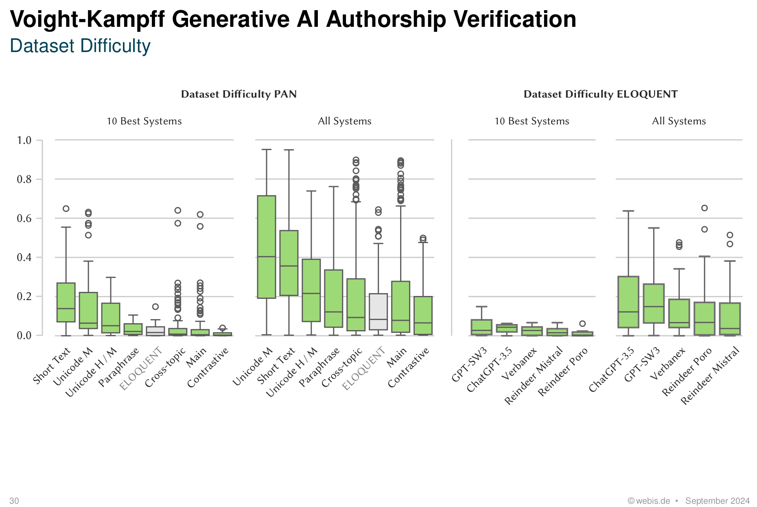
No.

Slide 33
Learnings
Very simple task to attract participants
Too simple to provide excitement

Slide 34
How did ELOQUENT do as a lab?

Slide 35
Attrition rate
55 registered teams
8 submitted experiments
Topical quiz: 27 registered teams; three quiz submissions; two response submissions
Hallucigen: 37 registered teams; 3 teams with 10 submissions
Robustness: 29 registered teams; 4 teams with 5 submissions
Voight-Kampff: 35 registered teams; three teams with 5 submissions (PAN side: 34 submitted classifiers)

Slide 36
Lessons learnt for next year
Longer schedule
Clearer scoring criteria and early release of test data
Balance complexity and low thresholds of entry
Rank order matters
Cast a wider net
Template report

Slide 37
once we have done this year's tasks we know how to evaluate LLMs and can distribute a conclusive report

Slide 38
once we have done this year's tasks we know how to evaluate LLMs and can distribute a conclusive report
actually, we think there may be more to investigate

Slide 39
ELOQUENT Sessions tomorrow!
11:15 - Details of 2024 experiments
14:00 - Plans for 2025

Slide 40
Jussi Karlgren
Silo AI
Aarne Talman
University of Helsinki
Liane Guillou
University of Edinburgh
Luise Dürlich, Evangelia Gogoulou, Shorouq Zahra, Joakim Nivre
RISE ICT
Magnus Sahlgren
AI Sweden

